Slide 1
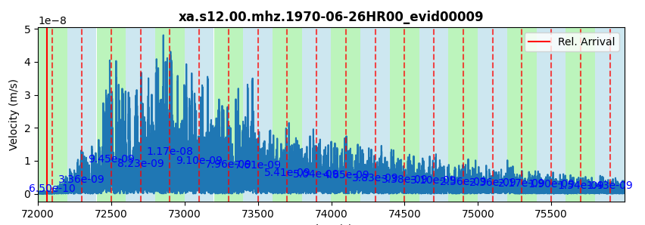

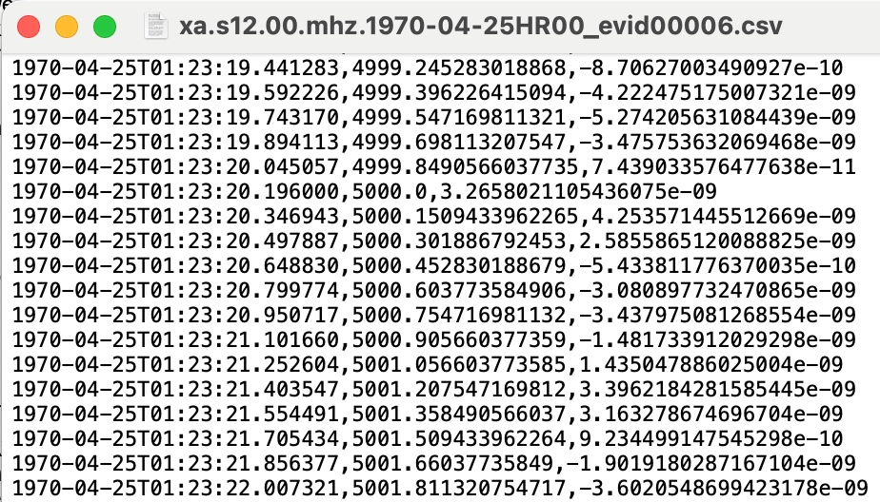
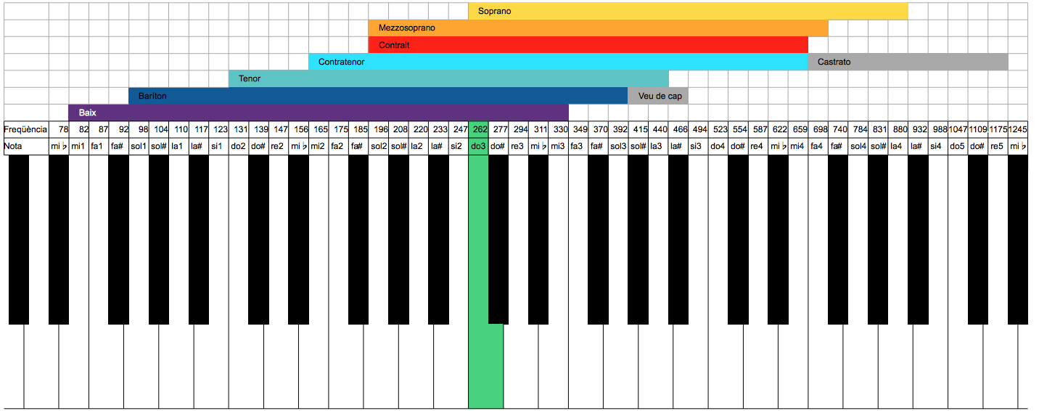
Notes:
<ENTER MELODY>
The melody that you just heard is the sonification of a moonquake. But how did we get here?

Slide 2
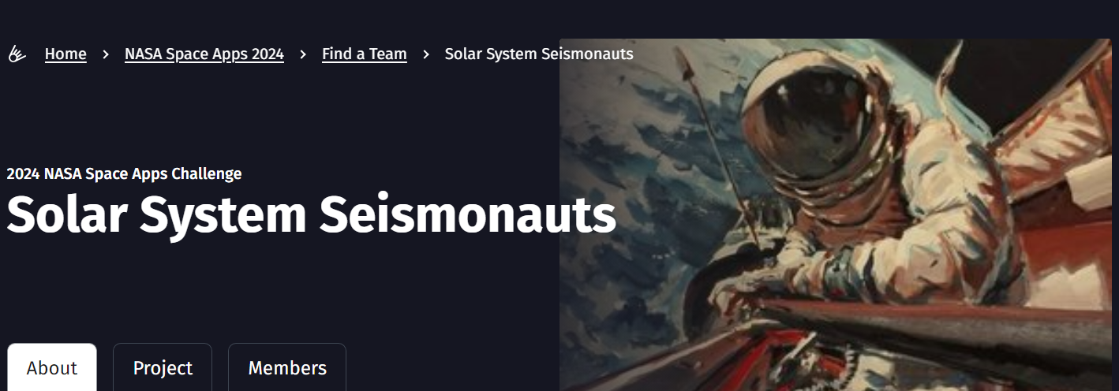
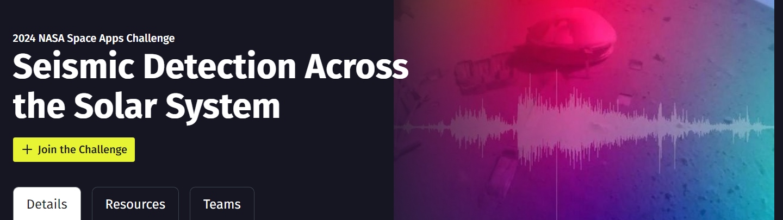
Notes:
First, What’s all this data and why it’s important? By studying seismic waves and how fast they travel, we can probe the structure and composition of the Earth and other planets as well, which is crucial for establishing habitability parameters of exoplanets. However, there's just one hiccup: sending data back over long distances in space requires a lot of power. To address this challenge, our team has done this:

Slide 3
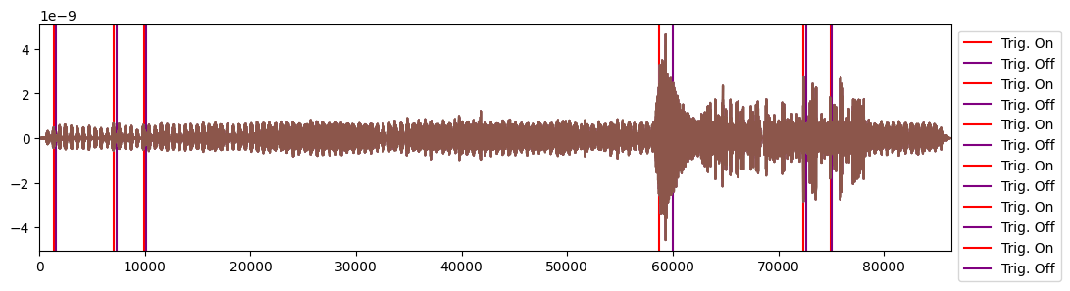
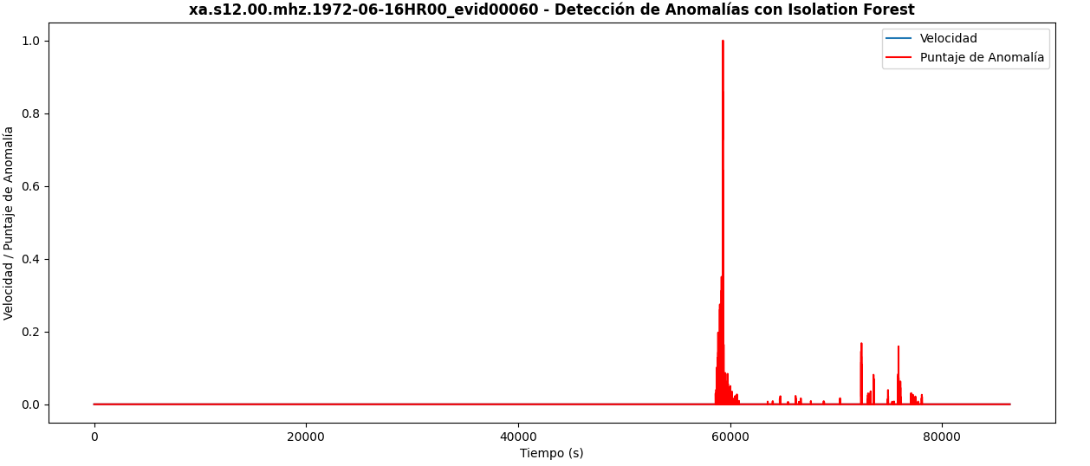

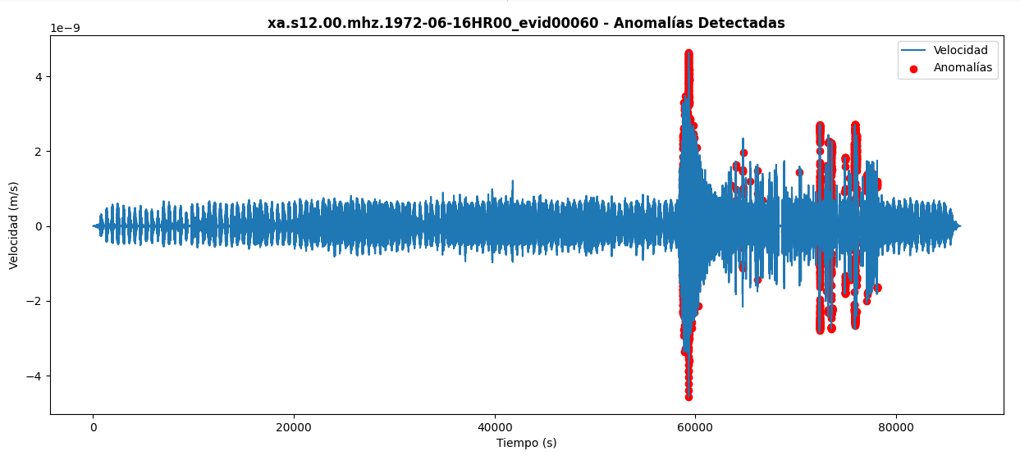
STA/LTA
ISOLATION FOREST
Notes:
We used a two-phase ensemble model.
First, we applied the STA/LTA algorithm, a state-of-the-art method for seismic detection. We optimized a grid of hyperparameters (windows and triggers) to minimize the mean absolute error (real relative time - predicted relative time) over a training set of 10 files, which outputs different candidate windows for seismic events.

Slide 4
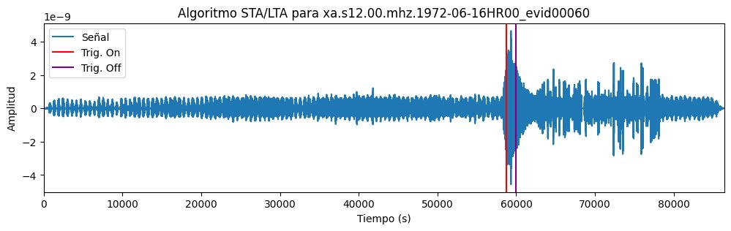
Notes:
In the (majority) case where the algorithm generated multiple candidate windows for a seism, the predicted window was selected as the one with the highest density of anomalies detected by the Isolation Forest algorithm.

Slide 5
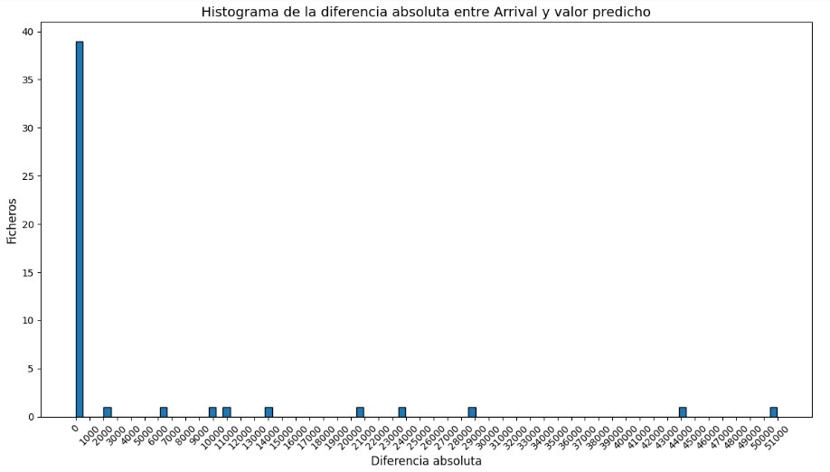
< 5 minutes
3%
Notes:
This approach resulted in remarkable outcomes on a training set of 50 files, with a mean absolute error of less than five minutes (which corresponds to about 3%) in 40 out of the 50 files.

Slide 6
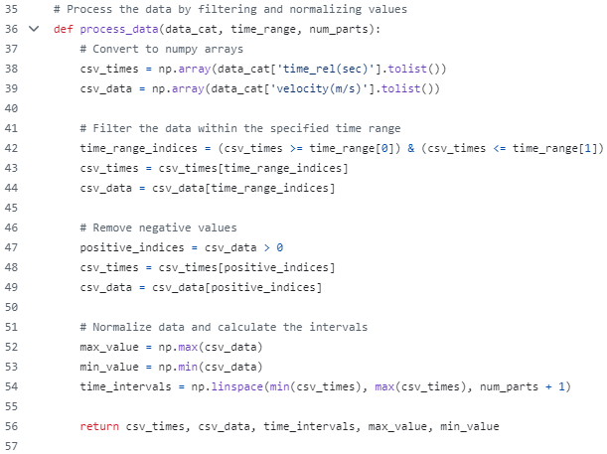

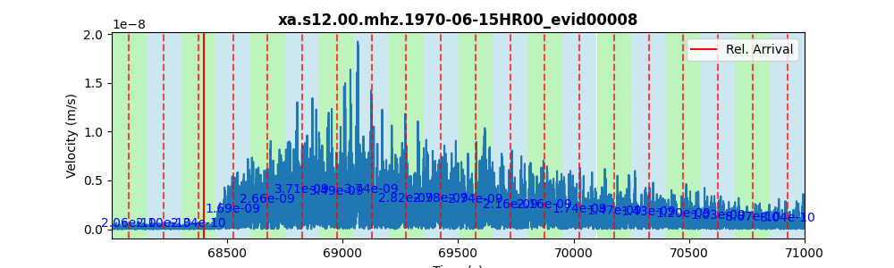
SONIFICATION
Notes:
Sonification is the representation of data sets through sound to facilitate their communication and interpretation. We implemented this concept in the challenge because, not only does it provide a solution to the problem, but it also brings this type of project closer to the public by allowing them to appreciate the data through music and visualizations, as we have done. This makes the data more accessible. Additionally, sonification is already used in science to assist blind scientists, among other applications. Here's how we implemented it:

Slide 7
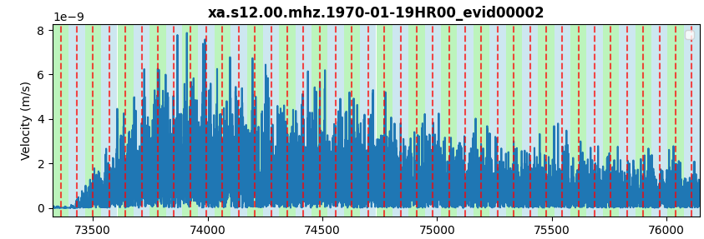
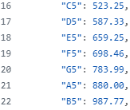

Notes:
1 With the data received from the final algorithm, we filter the time range where the seismic event occurs.
2 We fragment the signal into n parts.
3 We assign a frequency to the velocity (m/s) in each fragment.
4 We merge all the frequencies into a .wav file.
5 We create an animated graph using data from the CSV file (average and median samples).
6 We add the audio track from step 4 to the video file from step 5.
This is an innovative solution and has a practical use. And thank you for listening.

